Slide 1
Course Code: ICT-4103
Course Title: DigitaL ImaGe Processing
Book:
Digital image processing by Rafael C. Gonzalez and Richard E. Woods
Fundamentals of Digital Image Processing by S. Annadurai
Digital Image Processing: Whole world can be represented as data or information
“One picture is worth more than one thousand words”

Slide 2
Why digital image processing is necessary
•Digital image processing focuses on two major tasks
– Improvement of pictorial information for human interpretation
– Processing of image data for storage, transmission and representation for autonomous machine perception

Slide 3
What is digital Image
A digital image is an image composed of picture elements, also known as pixels, each with finite, discrete quantities of numeric representation for its intensity as gray level that is an output from its 2D functions fed as input by its spatial coordinates denoted by x and y on the x-axis and y-axis respectively.
The 2D functions can be written as f(x,y) whose x and y are spatial coordinates.
The amplitude of f is called the intensity or grey level at the point (x,y).
A digital image which is composed of a finite number of elements called picture elements, image elements, pels or pixels.

Slide 4
What is digital image processing
Digital image processing (DIP) is to process digital images by digital computers. Dip can be categorize by three levels.
Low-level Process: both input and output are images
Noise reduction, Contrast enhancement and also image sharpening
Mid-level Process: inputs are images and outputs are images attributes
Segmentation and classification of objects
High-level Process: Making sense of the ensemble of recognized objects for performing cognitive functions i.e. inputs are attributes and output is understanding. For example: scene understanding and autonomous navigation

Slide 5
History of Digital image processing
•Early 1920s: One of the first applications of digital imaging was in the newspaper industry
– The Bartlane cable picture transmission service
– Images were transferred by submarine cable between London and New York
– Pictures were coded for cable transfer and reconstructed at the receiving end on a telegraph printer

Slide 6
History of Digital image processing
Mid to late 1920s: Improvements to theBartlane system resulted in higher quality images
– New reproduction processes based on photographic techniques
– Increased number of tones in reproduced images

Slide 7
History of Digital image processing
•1960s: Improvements in computing technology and the onset of the space race led to a surge of work in digital image processing
– 1964: Computers used to improve the quality of images of the moon taken by the Ranger 7 probe
– Such techniques were used in other space missions including the Apollo landings

Slide 8
History of Digital image processing
•1970s: Digital image processing begins to be used in medical applications
– 1979: Sir Godfrey N. Hounsfield & Prof. Allan M. Cormack share the NobelPrize in medicine for the invention of tomography, the technology behind Computerised Axial Tomography (CAT) scans

Slide 9
History of Digital image processing
•1980s - Today: The use of digital image processing techniques has exploded and they are now used for all
kinds of tasks in all kinds of areas
– Image enhancement/restoration
– Artistic effects
– Medical visualisation
– Industrial inspection
– Law enforcement
– Human computer interfaces

Slide 10
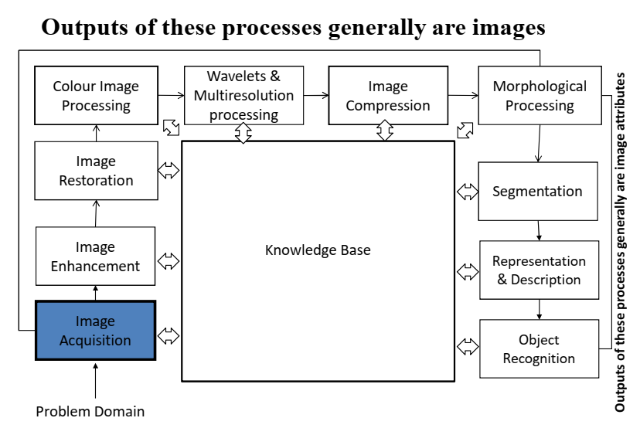
Fundamental Steps in digital image processing

Slide 11
Fundamental steps of digital image processing
Step 1: Image Acquisition
The image is captured by a sensor (eg. Camera), and digitized if the output of the camera or sensor is not already in digital form, using analogue-to-digital convertor
Step 2: Image Enhancement
The process of manipulating an image so that the result is more suitable than the original for specific applications. The idea behind enhancement techniques is to bring out details that are hidden, or simple to highlight certain features of interest in an image.

Slide 12
Fundamental steps of digital image processing
Step 3: Image Restoration
- Improving the appearance of an image
Tend to be mathematical or probabilistic models. Enhancement, on the other hand, is based on human subjective preferences regarding what constitutes a “good” enhancement result.
Step 4: Colour Image Processing
Use the colour of the image to extract features of interest in an image
Step 5: Wavelets
Are the foundation of representing images in various degrees of resolution. It is used for image data compression.

Slide 13
Fundamental steps of digital image processing
Step 6: Compression
Techniques for reducing the storage required to save an image or the bandwidth required to transmit it.
Step 7: Morphological Processing
Tools for extracting image components that are useful in the representation and description of shape.
In this step, there would be a transition from processes that output images, to processes that output
image attributes.

Slide 14
Fundamental steps of digital image processing
Step 8: Image Segmentation
Segmentation procedures partition an image into its constituent parts or objects.
Important Tip: The more accurate the segmentation, the more likely recognition is to succeed.
Step 9: Representation and Description
- Representation: Make a decision whether the data should be represented as a boundary or as a complete region. It is almost always follows the output of a segmentation stage.
Boundary Representation: Focus on external shape characteristics, such as corners and inflections
Region Representation: Focus on internal properties, such as texture or skeleton

